Slide 1
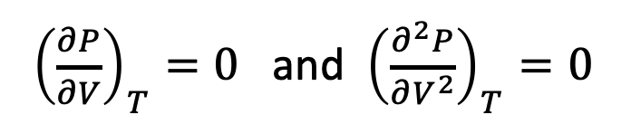
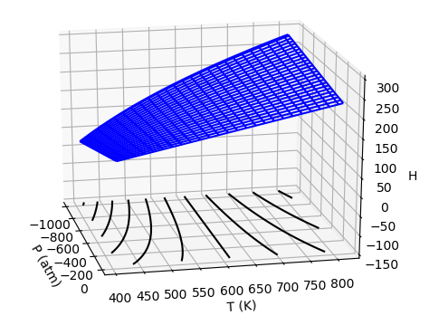
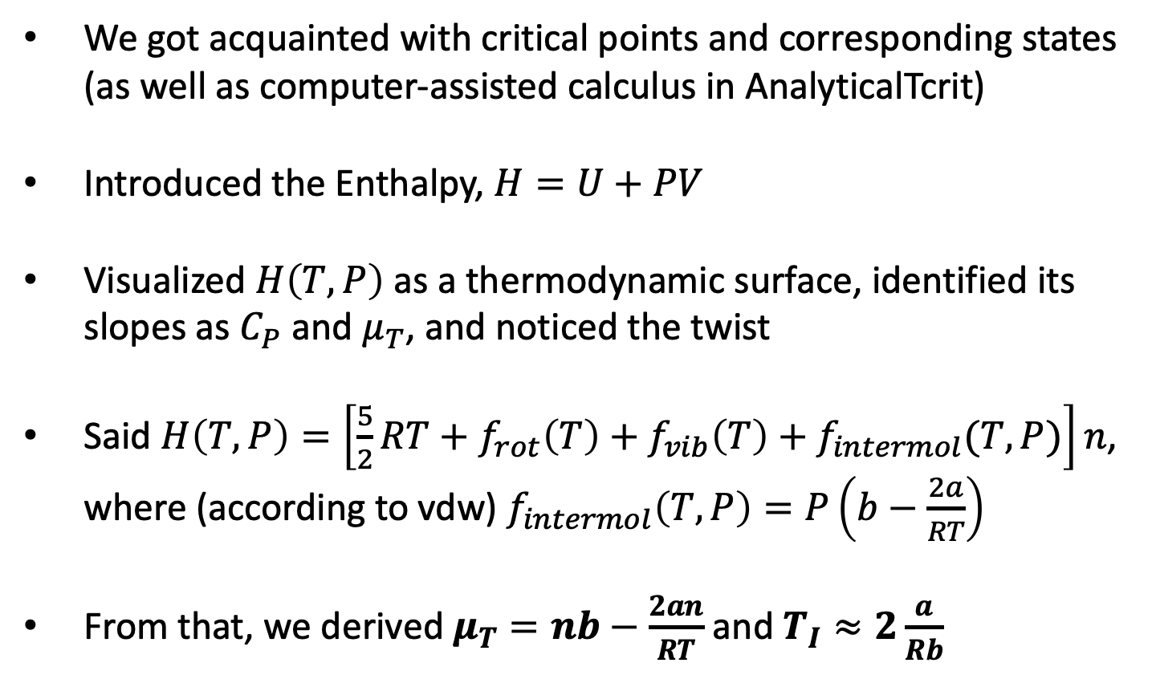
What we did this week
We got acquainted with critical points and corresponding states (as well as computer-assisted calculus in AnalyticalTcrit)
Introduced the Enthalpy, $H=U+PV$
Visualized $H\left(T,P\right)$ as a thermodynamic surface, identified its slopes as $C_{P}$ and $μ_{T}$, and noticed the twist
Said $H\left(T,P\right)=\left[\frac{5}{2}RT+f_{rot}\left(T\right)+f_{vib}\left(T\right)+f_{intermol}(T,P)\right]n$, where (according to vdw) $f_{intermol}\left(T,P\right)=P\left(b−\frac{2a}{RT}\right)$
From that, we derived $μ_{T}=nb−\frac{2an}{RT}$ and $T_{I}≈2\frac{a}{Rb}$

Slide 2
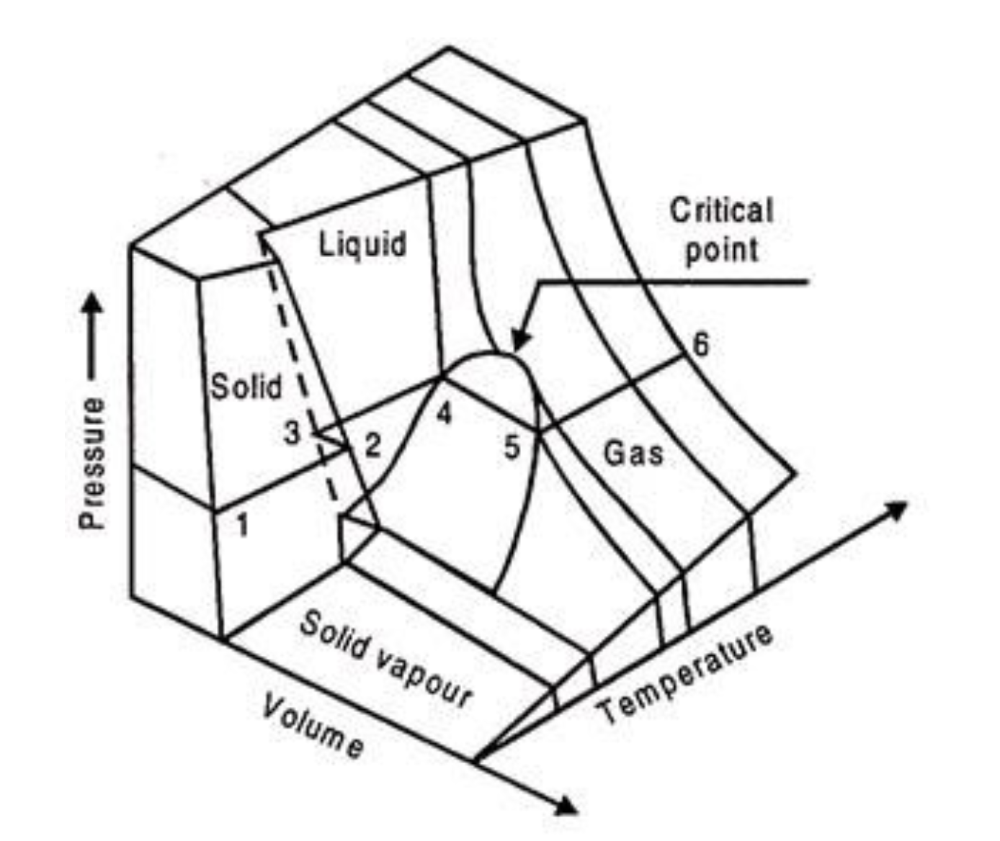
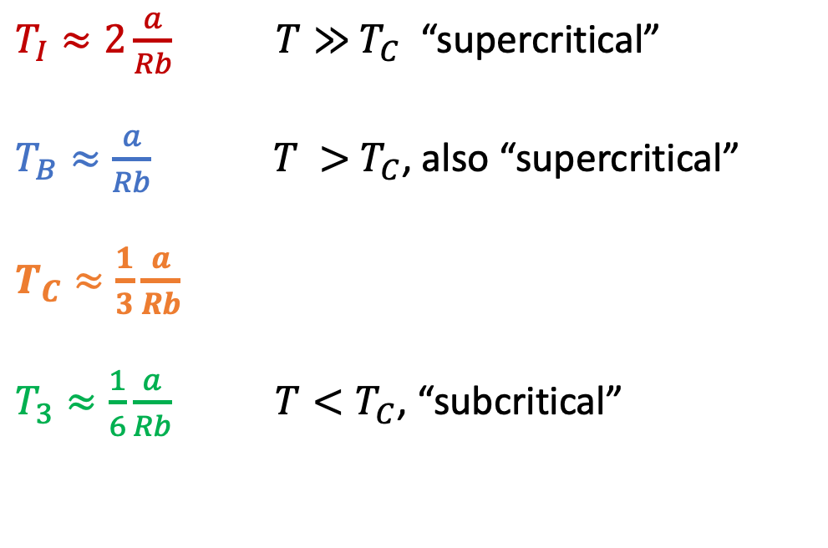
We saw how $\frac{a}{Rb}$ provides a unifying framework for multiple phenomena
$T_{I}≈2\frac{a}{Rb}$ $T≫{ T}_{C}$ “supercritical”
$T_{B}≈\frac{a}{Rb}$ $T >{ T}_{C}$, also “supercritical”
$T_{C}≈\frac{1}{3}\frac{a}{Rb}$
$T_{3}≈\frac{1}{6}\frac{a}{Rb}$ $T<T_{C}$, “subcritical”
https://www.engineeringenotes.com/thermal-engineering/real-gases/real-gases-properties-van-der-waals-equation-and-equation-of-state-thermal-engineering/49112

Slide 3
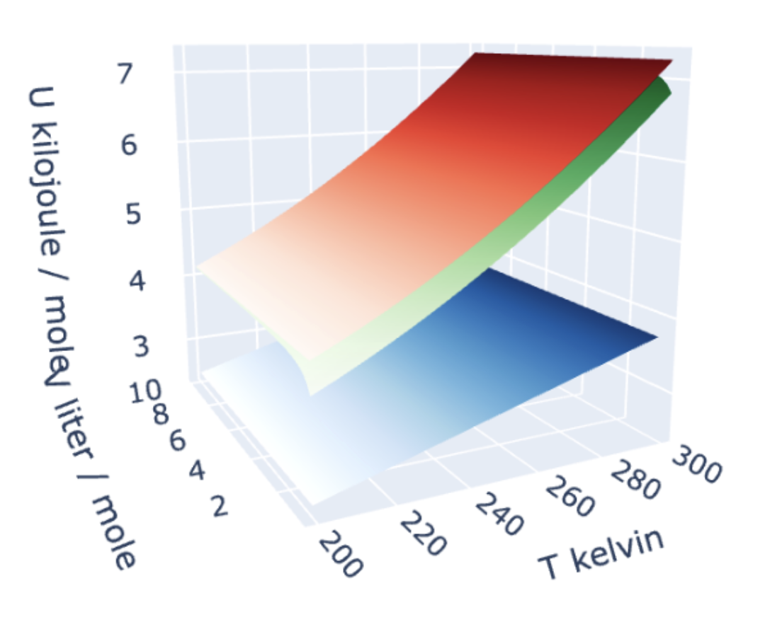
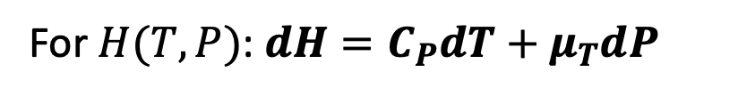
We also introduced differential equations of state
For $U(T,V)$: $dU=C_{V}dT+π_{T}dV$
For $H(T,P)$: $dH=C_{P}dT+μ_{T}dP$

Slide 4
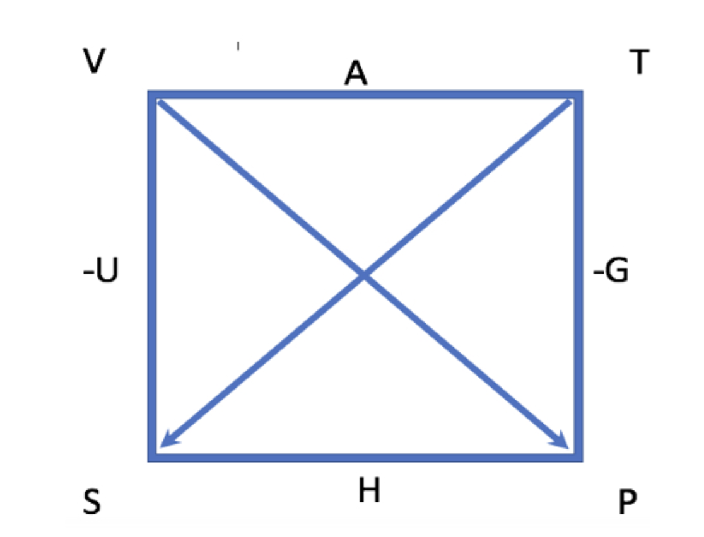
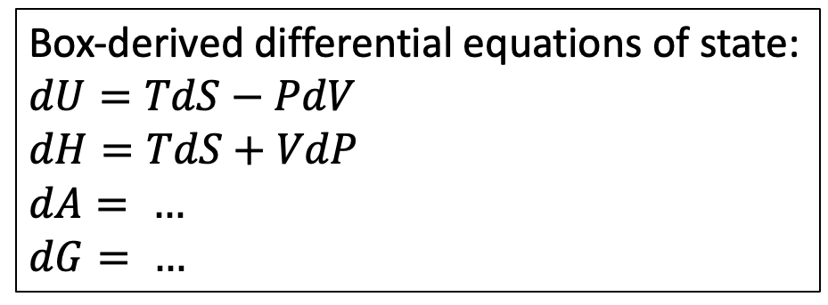
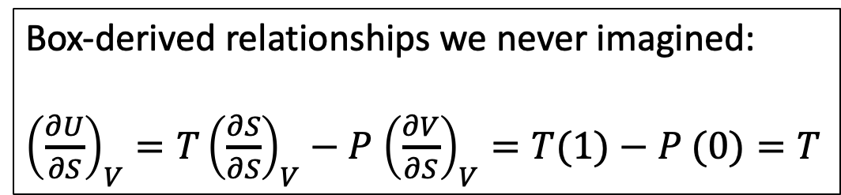
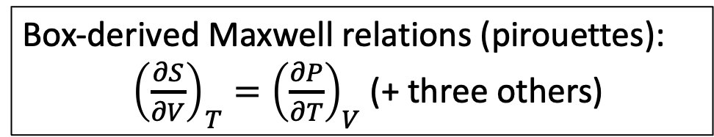
We introduced The Box:
Box-derived Maxwell relations (pirouettes):
${\left(\frac{∂S}{∂V}\right)}_{T}={\left(\frac{∂P}{∂T}\right)}_{V}$ (+ three others)
Box-derived differential equations of state:
$$dU=TdS−PdV$$
$$dH=TdS+VdP$$
$$dA= …$$
$$dG= …$$
Box-derived relationships we never imagined:
${\left(\frac{∂U}{∂S}\right)}_{V}=T{\left(\frac{∂S}{∂S}\right)}_{V}−P$ ${\left(\frac{∂V}{∂S}\right)}_{V}=T(1)−P (0)=T$

Slide 5

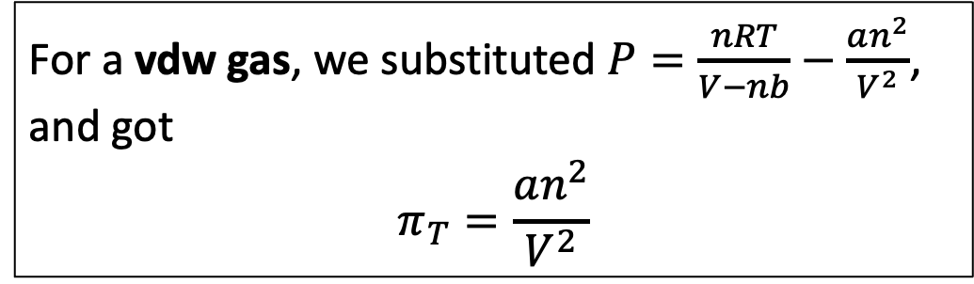
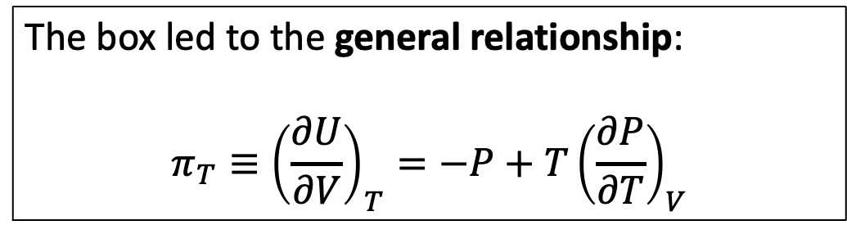
We used the box to get expressions for $π_{T}$
The box led to the general relationship:
$$π_{T}≡{\left(\frac{∂U}{∂V}\right)}_{T}={−P+T\left(\frac{∂P}{∂T}\right)}_{V}$$
For a vdw gas, we substituted $P=\frac{nRT}{V−nb}−\frac{an^{2}}{V^{2}}$, and got
$$π_{T}=\frac{an^{2}}{V^{2}}$$
For an ideal gas, $a=0$ and $b=0$, so
$$π_{T}=0$$

Slide 6
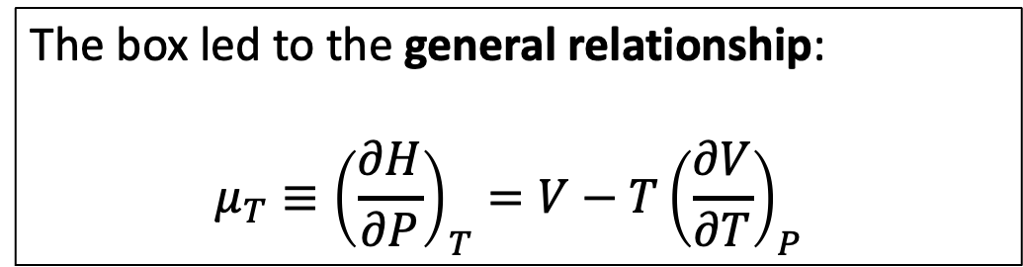
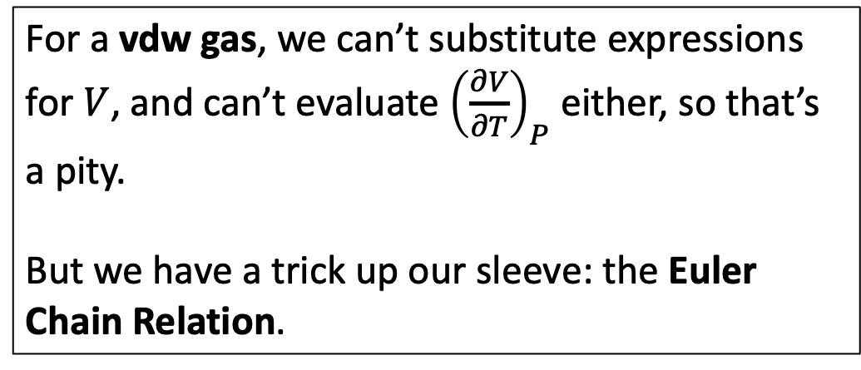
We also used the box to get expressions for $μ_{T}$
The box led to the general relationship:
$$μ_{T}≡{\left(\frac{∂H}{∂P}\right)}_{T}={V−T\left(\frac{∂V}{∂T}\right)}_{P}$$
For a vdw gas, we can’t substitute expressions for $V$, and can’t evaluate ${\left(\frac{∂V}{∂T}\right)}_{P}$ either, so that’s a pity.
But we have a trick up our sleeve: the Euler Chain Relation.

Slide 7
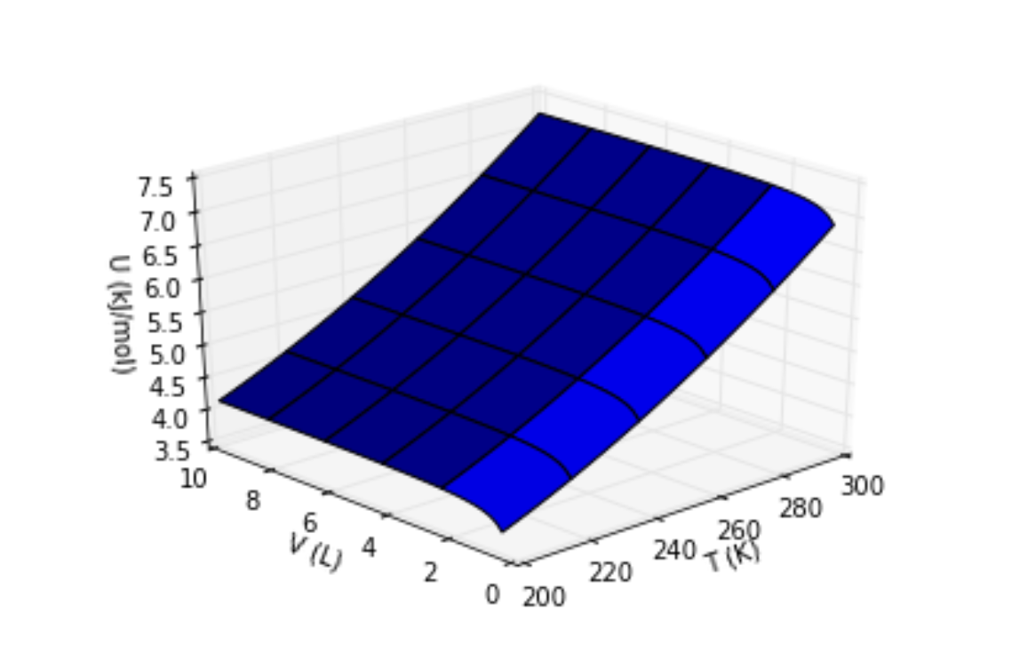

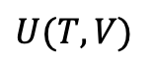
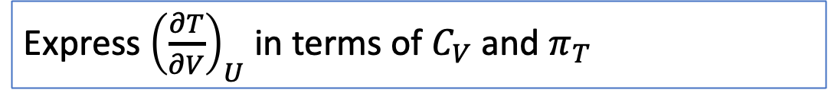
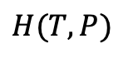
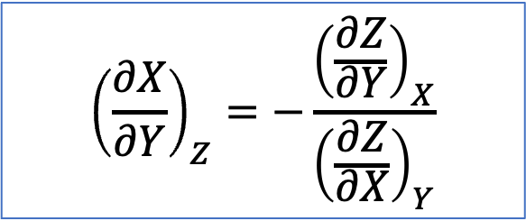
Blackboard work: the Euler Chain Relation
The Euler Chain Relation connects slopes to each other.
It’s especially useful when ${\left(\frac{∂X}{∂Y}\right)}_{Z}$ is a contour of a surface we’re interested in. Let’s practice with these:
$${\left(\frac{∂X}{∂Y}\right)}_{Z}=−\frac{{\left(\frac{∂Z}{∂Y}\right)}_{X}}{{\left(\frac{∂Z}{∂X}\right)}_{Y}}$$
$$U(T,V)$$
Express ${\left(\frac{∂T}{∂V}\right)}_{U}$ in terms of $C_{V}$ and $π_{T}$
$$H(T,P)$$
Express ${\left(\frac{∂T}{∂P}\right)}_{H}$ (which gets its own name: $μ_{JT}$) in terms of $C_{P}$ and $μ_{T}$

Slide 8
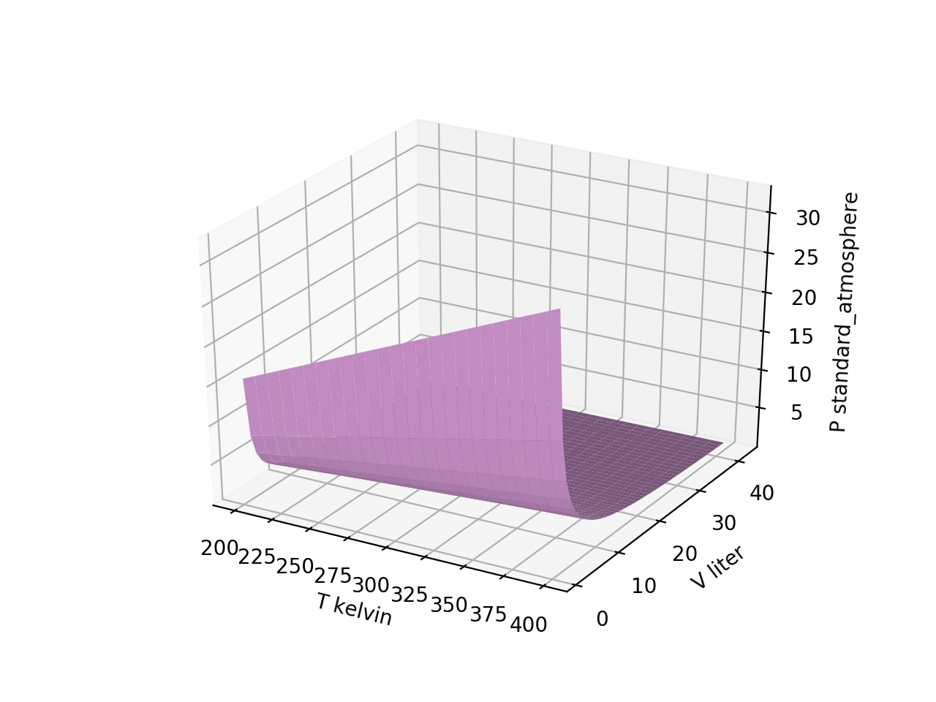
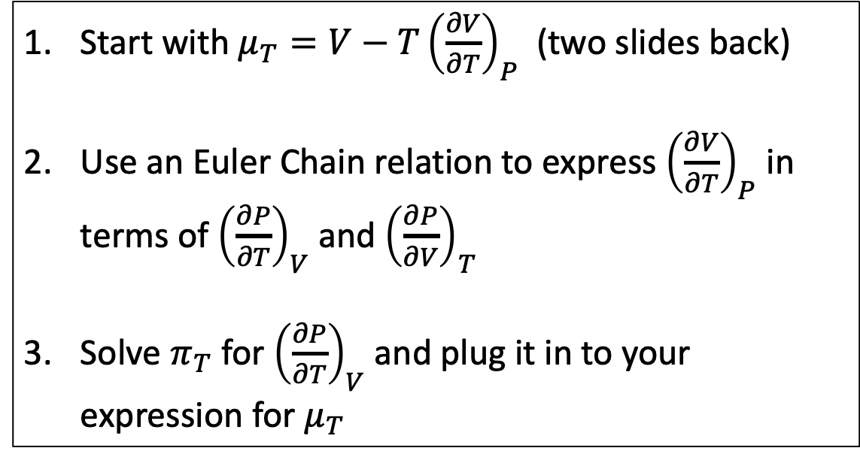
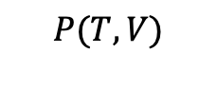
Blackboard: Using the Euler Chain Relation to replace that pesky ${\left(\frac{∂V}{∂T}\right)}_{P}$ in $μ_{T}={V−T\left(\frac{∂V}{∂T}\right)}_{P}$
Start with $μ_{T}={V−T\left(\frac{∂V}{∂T}\right)}_{P}$ (two slides back)
Use an Euler Chain relation to express ${\left(\frac{∂V}{∂T}\right)}_{P}$ in terms of ${\left(\frac{∂P}{∂T}\right)}_{V}$ and ${\left(\frac{∂P}{∂V}\right)}_{T}$
Solve $π_{T}$ for ${\left(\frac{∂P}{∂T}\right)}_{V}$ and plug it in to your expression for $μ_{T}$
$$P(T,V)$$

Slide 9
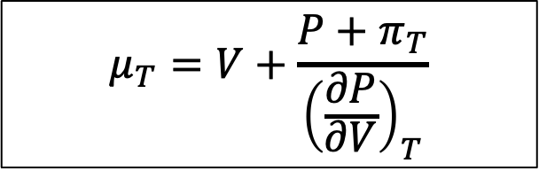
Blackboard: Using the Euler Chain Relation to replace that pesky ${\left(\frac{∂V}{∂T}\right)}_{P}$ in $μ_{T}={V−T\left(\frac{∂V}{∂T}\right)}_{P}$
Start with $μ_{T}={V−T\left(\frac{∂V}{∂T}\right)}_{P}$ (two slides back)
Use an Euler Chain relation to express ${\left(\frac{∂V}{∂T}\right)}_{P}$ in terms of ${\left(\frac{∂P}{∂T}\right)}_{V}$ and ${\left(\frac{∂P}{∂V}\right)}_{T}$
Solve $π_{T}$ for ${\left(\frac{∂P}{∂T}\right)}_{V}$ and plug it in to your expression for $μ_{T}$
$$P(T,V)$$
$$μ_{T}=V+\frac{P+π_{T}}{{\left(\frac{∂P}{∂V}\right)}_{T}}$$

Slide 10
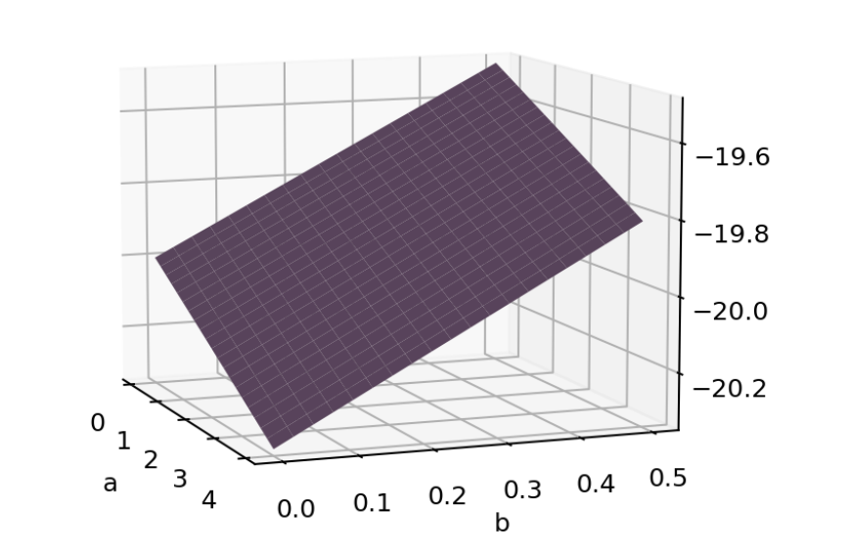
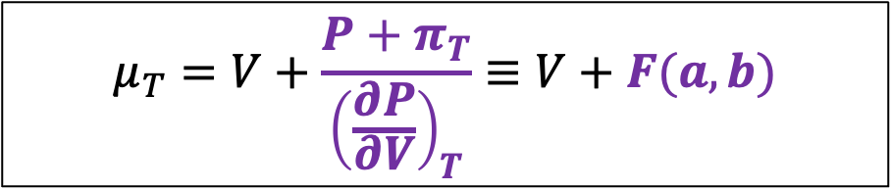
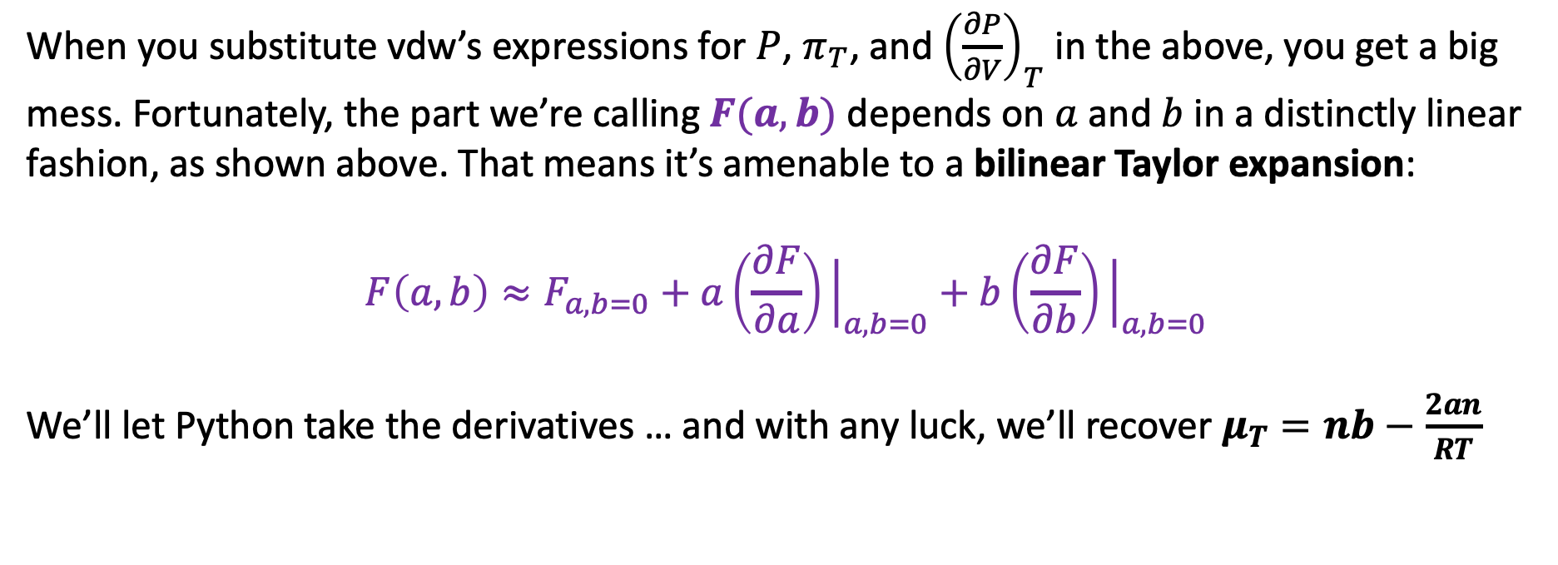

Simplifying $μ_{T}$
$$F(a,b)$$
$$μ_{T}=V+\frac{P+π_{T}}{{\left(\frac{∂P}{∂V}\right)}_{T}}≡V+F(a,b)$$
When you substitute vdw’s expressions for $P$, $π_{T}$, and ${\left(\frac{∂P}{∂V}\right)}_{T}$ in the above, you get a big mess. Fortunately, the part we’re calling $F(a,b)$ depends on $a$ and $b$ in a distinctly linear fashion, as shown above. That means it’s amenable to a bilinear Taylor expansion:
$$F\left(a,b\right)≈F_{a,b=0}+a\left(\frac{∂F}{∂a}\right){\left.​\right|}_{a,b=0}+b\left(\frac{∂F}{∂b}\right){\left.​\right|}_{a,b=0}$$
We’ll let Python take the derivatives … and with any luck, we’ll recover $μ_{T}=nb−\frac{2an}{RT}$

Slide 11
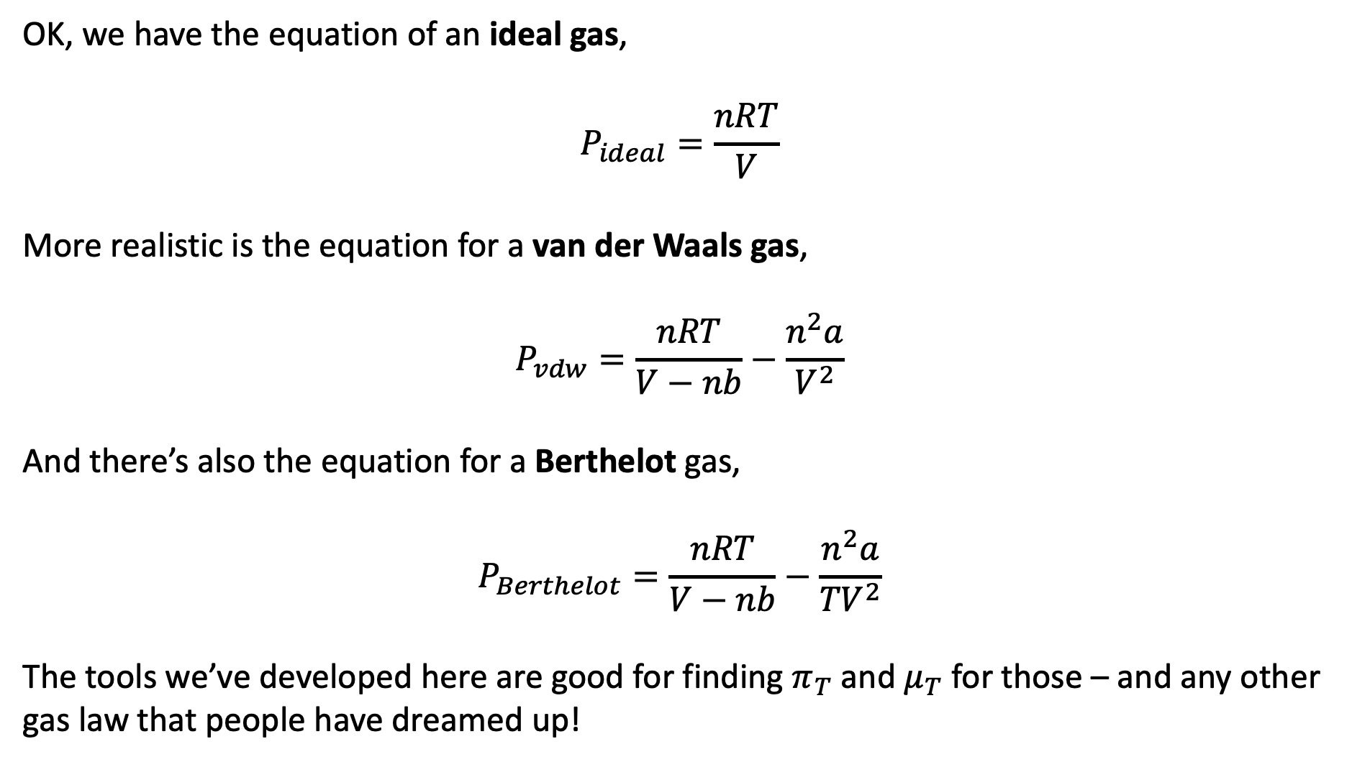
Ideal, van der Waals, and Berthelot (wrap-up)
OK, we have the equation of an ideal gas,
$$P_{ideal}=\frac{nRT}{V}$$
More realistic is the equation for a van der Waals gas,
$$P_{vdw}=\frac{nRT}{V−nb}−\frac{n^{2}a}{V^{2}}$$
And there’s also the equation for a Berthelot gas,
$$P_{Berthelot}=\frac{nRT}{V−nb}−\frac{n^{2}a}{{TV}^{2}}$$
The tools we’ve developed here are good for finding $π_{T}$ and $μ_{T}$ for those – and any other gas law that people have dreamed up!

Slide 12
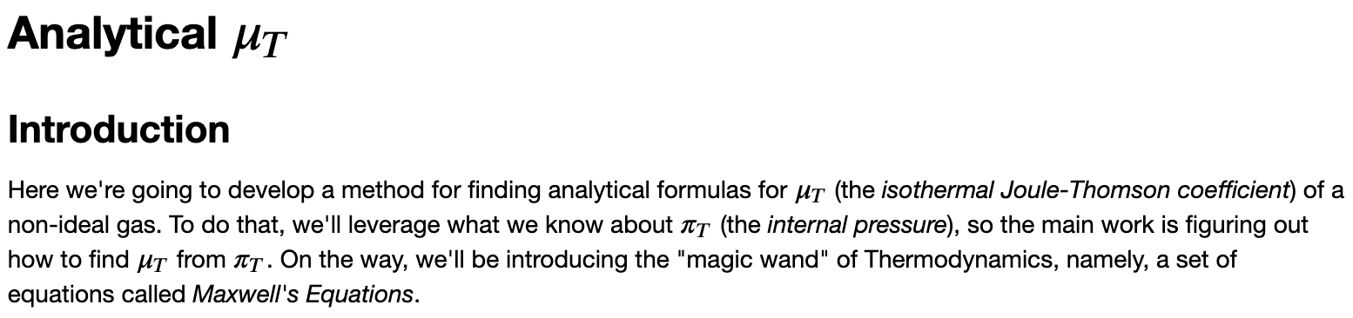
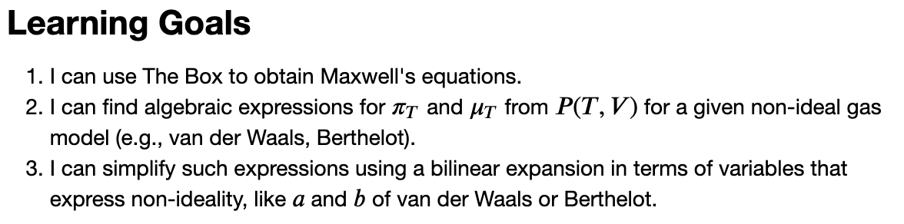
OK, let’s get started …

